Slide 1
Chapter 11:
Exception Handling

Slide 2
Objectives
Learn about exceptions, the Exception class, and generating System Exceptions.
Learn about traditional and object-oriented error-handling methods.
Use the Exception class’s ToString() method and Message property.
Catch multiple exceptions.
Examine the structure of the TryParse() methods.

Slide 3
Objectives
Use the finally block.
Handle exceptions thrown from outside methods.
Trace Exception objects through the call stack.
Create your own Exception classes.
Rethrow Exceptions.

Slide 4
Understanding Exceptions
An exception is any error condition or unexpected behavior in an executing program.
The object-oriented techniques used to manage such errors make up the group of methods known as exception handling.
Exceptions are objects of the Exception class or one of its derived classes.
An exception condition generates an object that encapsulates information about the error.

Slide 5
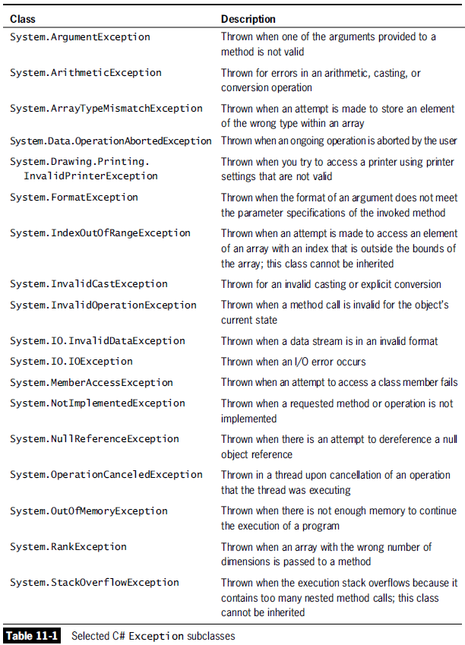

Slide 6
Understanding Exceptions
Most exceptions you will use derive from three classes:
The predefined Common Language Runtime exception classes derived from SystemException.
The user-defined application exception classes you derive from ApplicationException.
The Exception class, which is the parent of SystemException and ApplicationException.

Slide 7
Purposely Generating a SystemException
You can deliberately generate a SystemException by forcing a program to contain an error.
As an example, in every programming language, it is illegal to divide an integer by zero because the operation is mathematically undefined.
Object-oriented error-handling techniques provide solutions to error situations – like dividing an integer by zero.

Slide 8
Understanding Traditional and Object-Oriented Error-Handling Methods
Dividing by zero is an avoidable error – simply check a variable’s value with an if statement before attempting to divide it into another number.
This prevents division by zero. However, it does not really “handle an exception,” because no Exception class object was created.

Slide 9
Understanding Object-Oriented Exception-Handling Methods
Object-oriented exception handling uses three unique terms: try, throw, and catch.
You “try” a code statement that may not complete correctly (possible error condition).
A method that detects an error condition “throws” an exception.
The block of code that processes the error “catches” the exception.

Slide 10
Understanding Object-Oriented Exception-Handling Methods
A try block consists of the following elements:
The keyword try.
A pair of curly braces containing statements that can might cause exceptions (errors).
You must code at least one catch block or finally block immediately following a try block.
Each catch block can “catch” one type of Exception – that is, an Exception object or an object of one of its child classes.

Slide 11
Understanding Object-Oriented Exception-Handling Methods
A catch block consists of the following elements:
The keyword catch.
Parentheses containing an Exception type and, optionally, a name for an instance of the Exception type.
A pair of curly braces containing statements that deal with the error condition.

Slide 12
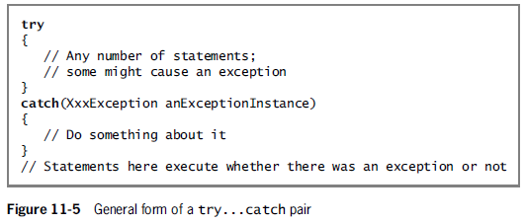
Understanding Object-Oriented Exception-Handling Methods

Slide 13
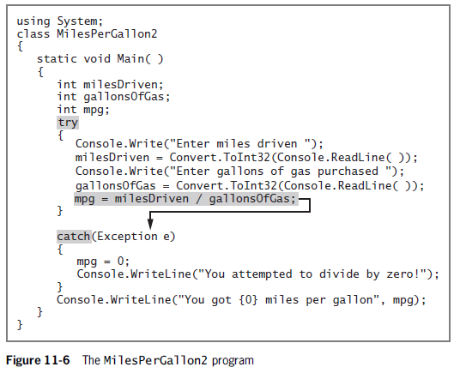
Understanding Object-Oriented Exception-Handling Methods

Slide 14
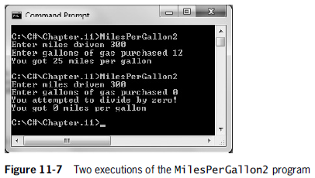
Understanding Object-Oriented Exception-Handling Methods

Slide 15
Using the Exception Class’s ToString() Method and Message Property
You don’t always have to write your own error message – instead, you can use the ToString() method that every Exception class inherits from the Object class.
The Exception class overrides ToString() to provide a descriptive error message so a user can receive precise information about the nature of any Exception that is thrown.

Slide 16
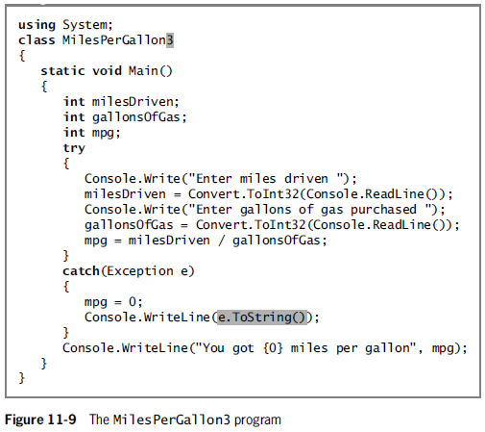
Using the Exception Class’s ToString() Method and Message Property

Slide 17
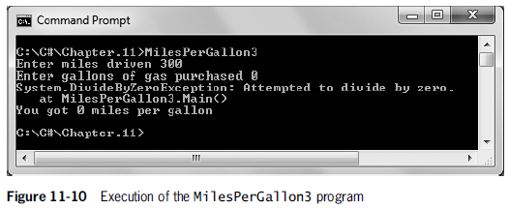
Using the Exception Class’s ToString() Method and Message Property

Slide 18
Using the Exception Class’s ToString() Method and Message Property
The Exception class contains a read-only property named Message that contains useful information about an Exception object.
The code on the next slide illustrates how to retrieve the return value from the Message property.

Slide 19
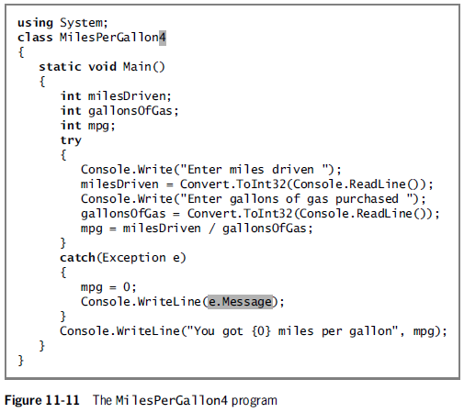
Using the Exception Class’s ToString() Method and Message Property

Slide 20
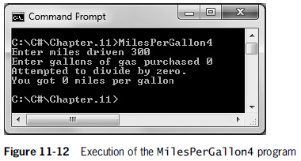
Using the Exception Class’s ToString() Method and Message Property

Slide 21
Catching Multiple Exceptions
You can place as many statements as you need within a try block, and you can include as many catch blocks as you want to handle different Exception types.
When a try block contains more than one statement, only the first error-generating statement throws an Exception.
As soon as the exception occurs, the logic transfers to the catch block, which leaves the rest of the statements in the try block unexecuted.

Slide 22
Catching Multiple Exceptions
When an Exception object is thrown and multiple catch blocks are present, the catch blocks are examined in sequence until a match is found.
The matching catch block then executes, and each remaining catch block is bypassed.
Various Exceptions can be handled by the same catch block

Slide 23
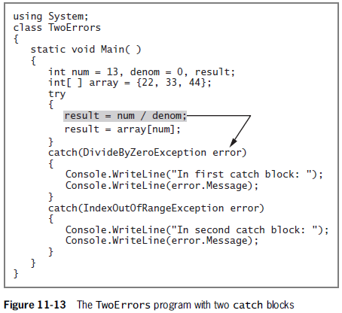
Catching Multiple Exceptions

Slide 24
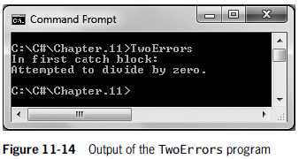
Catching Multiple Exceptions

Slide 25
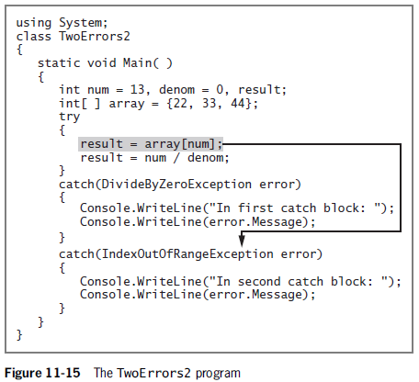
Catching Multiple Exceptions

Slide 26
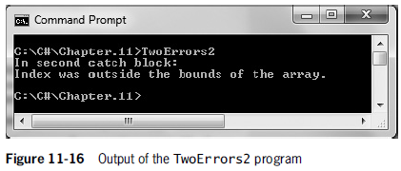
Catching Multiple Exceptions

Slide 27
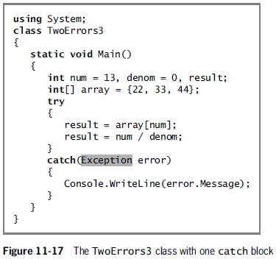
Catching Multiple Exceptions
Various Exceptions can be handled by the same catch block.

Slide 28
Catching Multiple Exceptions
It is poor coding style for a method to throw more than three or four types of exceptions.
If more than four exceptions can occur, then the following are probably true:
The method is trying to accomplish too many diverse tasks and should be broken up into smaller blocks or methods.
The Exception types thrown are too specific and should be generalized.

Slide 29
Catching Multiple Exceptions
When you list multiple catch blocks following a try block, you must be careful that some catch blocks don’t become unreachable.
Unreachable blocks contain statements that can never execute under any circumstances because the program logic “can’t get there.”
Programmers also call unreachable code dead code.

Slide 30
Examining the Structure of the TryParse() Methods
In Chapter 8, you learned about the TryParse() methods that you can use to convert string data to another type without fear of generating an exception.
If no TryParse() method existed to convert a string to another data type safely, you could write your own method to do so using a try block and a catch block – as illustrated on the following slide.

Slide 31
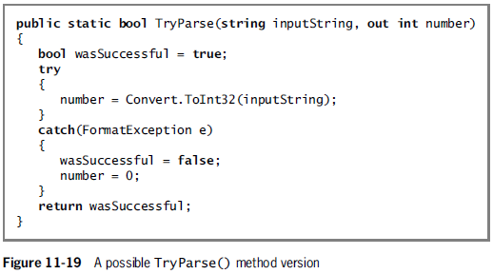
Examining the Structure of the TryParse() Methods

Slide 32
Using the finally Block
When you have actions to perform at the end of a try…catch sequence, you can use a finally block, which executes whether the try block identifies any exceptions or not.
finally blocks are used to perform clean-up tasks that might occur, regardless of whether any errors occurred or were caught.

Slide 33
Using the finally Block
A finally block executes after when any of the following occur:
The try ends normally.
The catch executes.
The try ends abnormally and the catch does not execute.

Slide 34
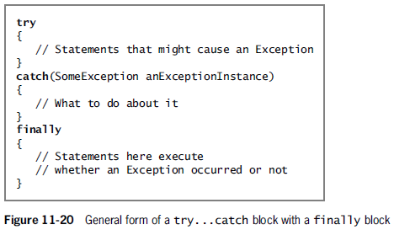
Using the finally Block

Slide 35
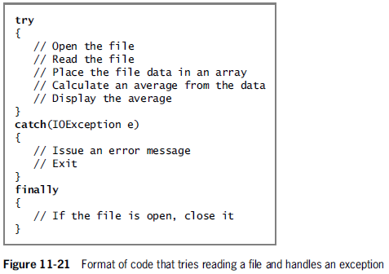
Using the finally Block

Slide 36
Handling Exceptions Thrown from Outside Methods
An advantage of using object-oriented exception-handling techniques is the ability to deal with exceptions appropriately as you decide how to handle them.
When methods from other classes throw exceptions, the methods do not have to catch them – instead, your calling program can catch them, and you can decide what to do.

Slide 37
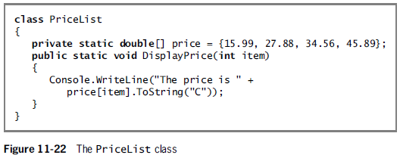
Handling Exceptions Thrown from Outside Methods

Slide 38
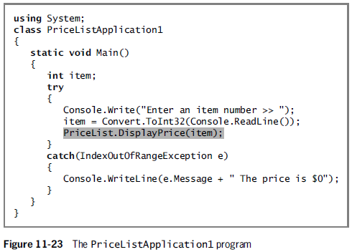
Handling Exceptions Thrown from Outside Methods

Slide 39
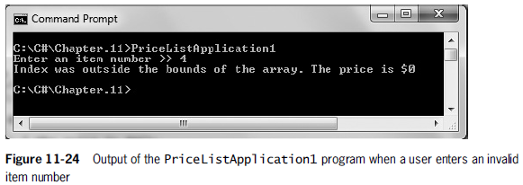
Handling Exceptions Thrown from Outside Methods

Slide 40
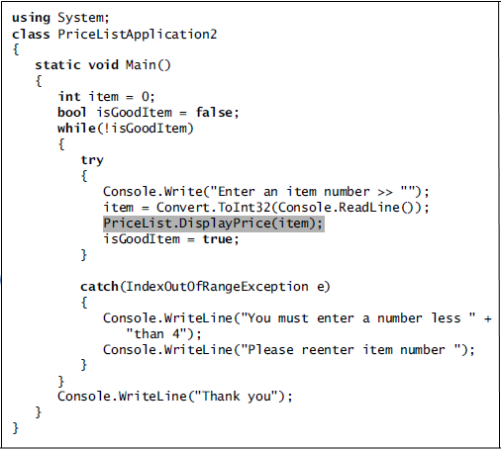
Handling Exceptions Thrown from Outside Methods

Slide 41
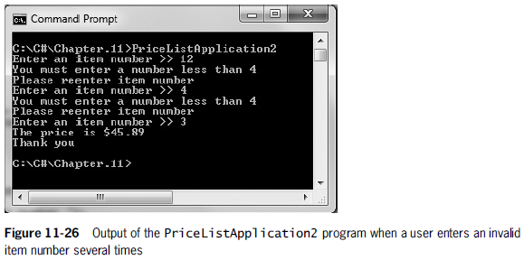
Handling Exceptions Thrown from Outside Methods

Slide 42
Tracing Exception Objects Through the Call Stack
The memory location where the computer stores the list of locations to which the system must return is known as the call stack.
If a method throws an exception and does not catch it, the exception is thrown to the next method “up” the call stack.
Consider the sequence of events shown on the next slide.

Slide 43
Tracing Exception Objects Through the Call Stack
1. MethodA() calls MethodB().
2. MethodB() calls MethodC().
3. MethodC() throws an exception.
4. C# looks first for a catch block in MethodC().
5. If none exists in MethodC(), then C# looks for the catch block in MethodB().
6. If none exists in MethodB(), then C# looks for the catch block in MethodA().
7. If MethodA() doesn’t catch the exception, then the program terminates and the operating system displays an error message.

Slide 44
Tracing Exception Objects Through the Call Stack
This system of passing an exception through the chain of calling methods is called propagating the exception.
The StackTrace property contains a list of methods in the call stack.
This list can help you to determine the location of the exception.

Slide 45
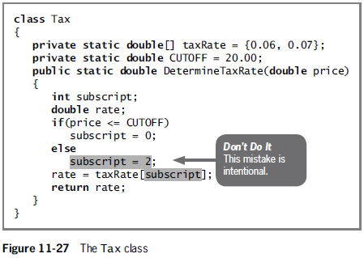
A Case Study: Using StackTrace

Slide 46
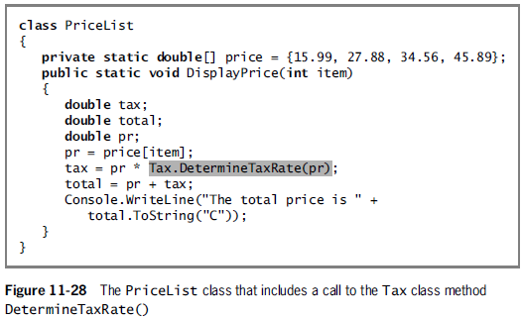
A Case Study: Using StackTrace

Slide 47
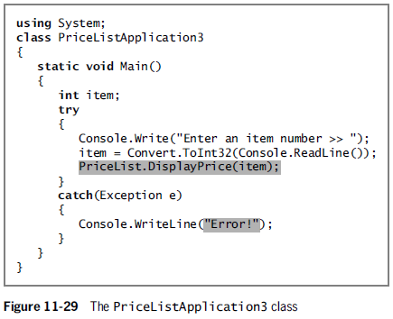
A Case Study: Using StackTrace

Slide 48
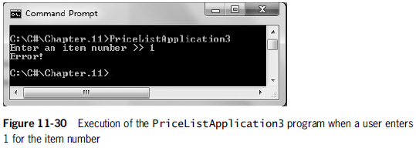
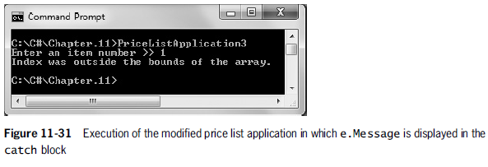
A Case Study: Using StackTrace

Slide 49
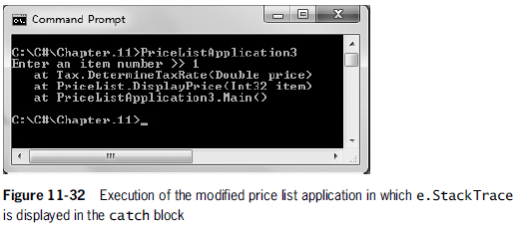
A Case Study: Using StackTrace

Slide 50
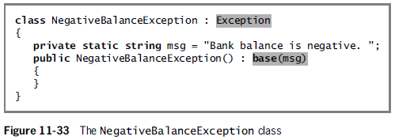
Creating Your Own Exception Classes
To create your own Exception type from which you can instantiate throwable objects, you can extend the ApplicationException class, or the Exception class.

Slide 51
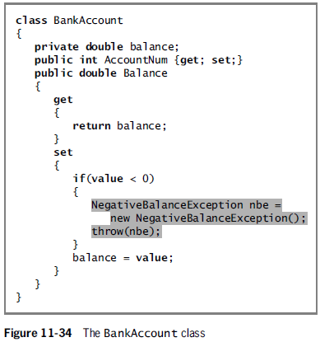
Creating Your Own Exception Classes

Slide 52
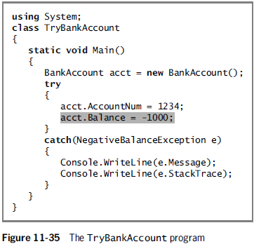
Creating Your Own Exception Classes

Slide 53
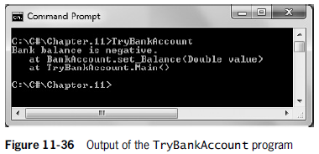
Creating Your Own Exception Classes

Slide 54
Rethrowing an Exception
When you rethrow the exception, you let the calling method handle the error condition – in other words the method that catches the exception does not have to handle it.
Within a catch block, you can rethrow the exception that was caught by using the keyword throw with no object after it.

Slide 55
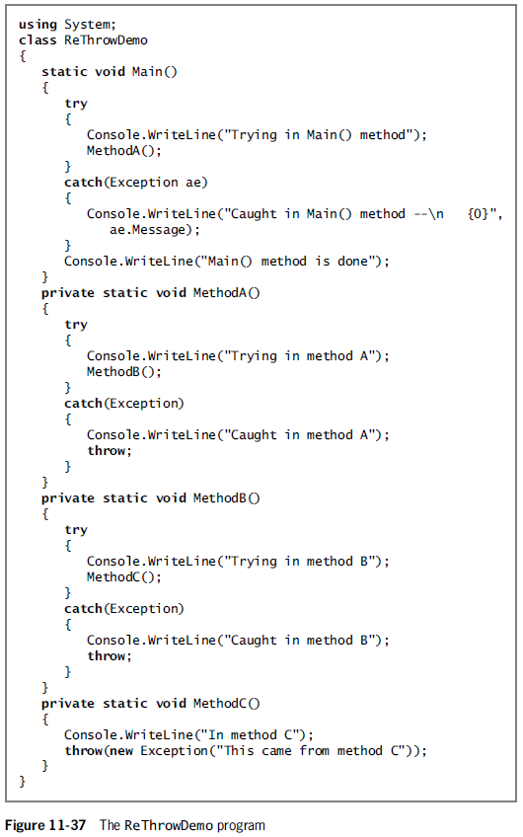

Slide 56
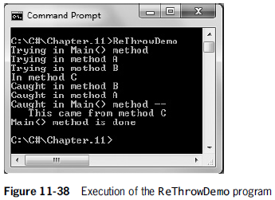
Rethrowing an Exception

